Slide 1
Learning with Limited Data for Multilingual Reading Comprehension
EMNLP ‘19
Kyungjae Lee1∗ Sunghyun Park1∗ Hojae Han1 Jinyoung Yeo3 Seung-won Hwang1† Juho Lee2
1Yonsei University, 2 NAVER Corp, 3 SK T-Brain

Slide 2
Contents
Task introduction
Model Overview
Method
Data Generation
Weakly-supervised QA model
Experiment
Conclusion

Slide 3
Task introduction
Supporting QA in new language with limited training resources
Current QA is using Human generated large size dataset
Mainly English dataset is only supported
Two possible solution
Build human generated dataset
Modeling to overcome the limitation of training resources

Slide 4
Task introduction
Modeling to overcome the limitation of training resources
Should consider in terms of quantity and quality

Slide 5
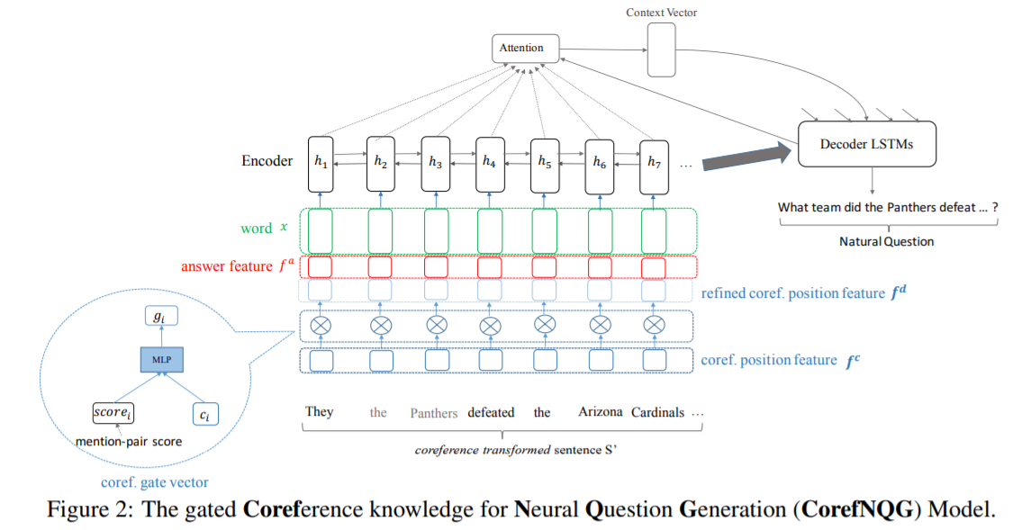
Task introduction
Modeling to overcome the limitation of training resources
Should consider in terms of quantity and quality
(1)
(2)
Q. What causes precipitation to fall?
A. gravity
NMT
Q. 강수의 원인은 무엇입니까?
A. 중력
Learning to Translate for Multilingual Question Answering
Harvesting Paragraph-Level Question-Answer Pairs from Wikipedia

Slide 6
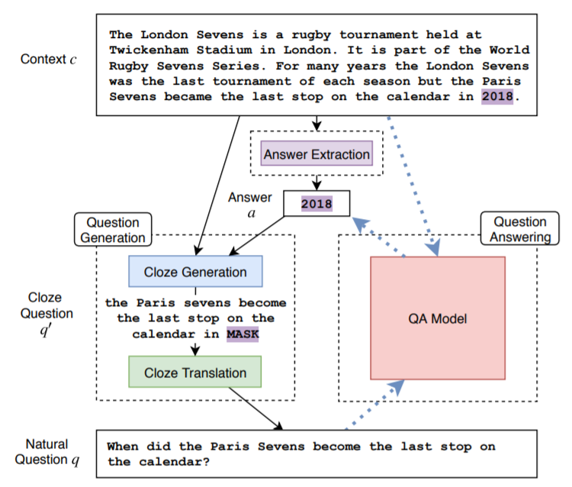
Task introduction
Modeling to overcome the limitation of training resources
Should consider in terms of quantity and quality
Unsupervised Question Answering by Cloze Translation

Slide 7
Task introduction
Modeling to overcome the limitation of training resources
Should consider in terms of quantity and quality
Answerability the semantic of the translated text changed, so that a question gets unanswerable
Answer alignment the answer span in a target language become incorrect

Slide 8
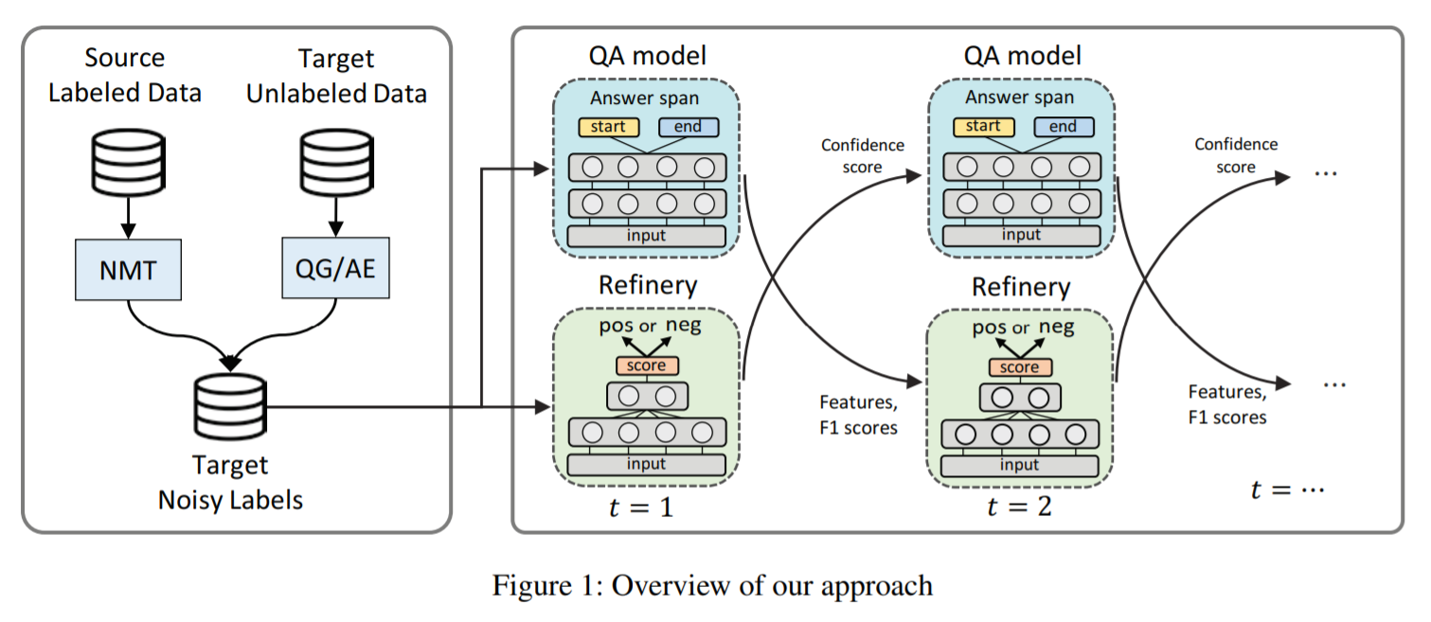
Model Overview

Slide 9
Data Generation | Method
Method 1. Neural Machine Translation
Translated answer may not appear in translated passage
One-to-one alignment
Span-to-span alignment

Slide 10
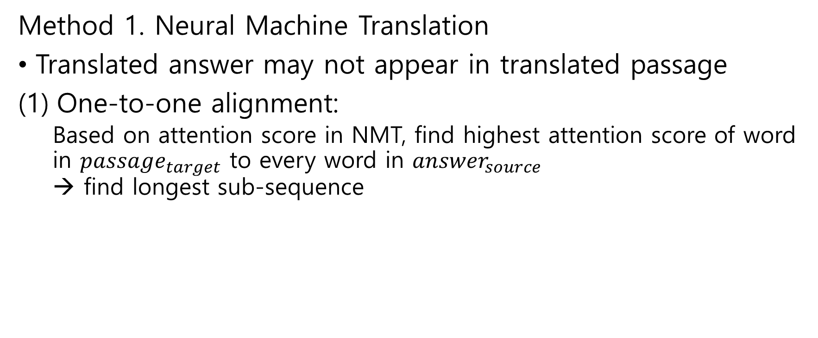
Data Generation | Method
Method 1. Neural Machine Translation
Translated answer may not appear in translated passage
One-to-one alignment:
Based on attention score in NMT, find highest attention score of word in ${passage}_{target}$ to every word in ${answer}_{source}$ → find longest sub-sequence

Slide 11
Data Generation | Method
Method 1. Neural Machine Translation
Translated answer may not appear in translated passage
One-to-one alignment:
passage
더 작은 물방울이 구름 내 다른 빗방울이나 얼음 결정과 충돌하여 합쳐지면서 강수량이 형성됩니다.
question
물방울이 얼음 결정과 어디에서 충돌하여 침전을 형성합니까?
answer
구름 안에서

Slide 12
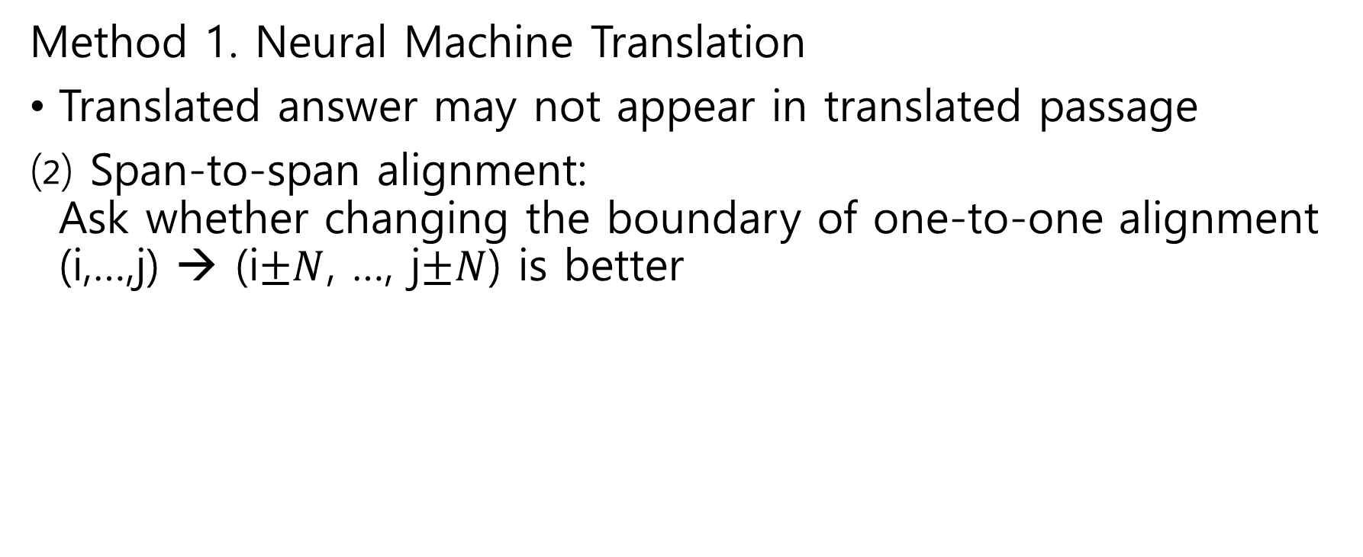
Data Generation | Method
Method 1. Neural Machine Translation
Translated answer may not appear in translated passage
Span-to-span alignment: Ask whether changing the boundary of one-to-one alignment (i,…,j) → (i$±N$, …, j$±N$) is better

Slide 13
Data Generation | Method
Method 2. Synthetic Label Generation
Automatic labeler which can generate question-answer pairs from unlabeled data

Slide 14
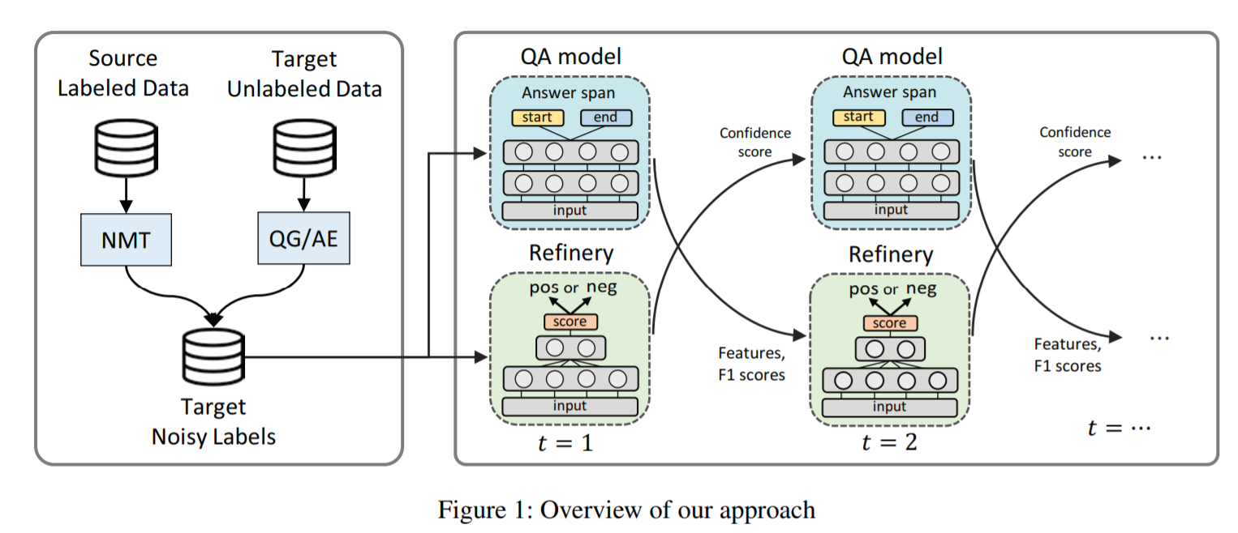
Weakly-supervised QA Model | Method

Slide 15
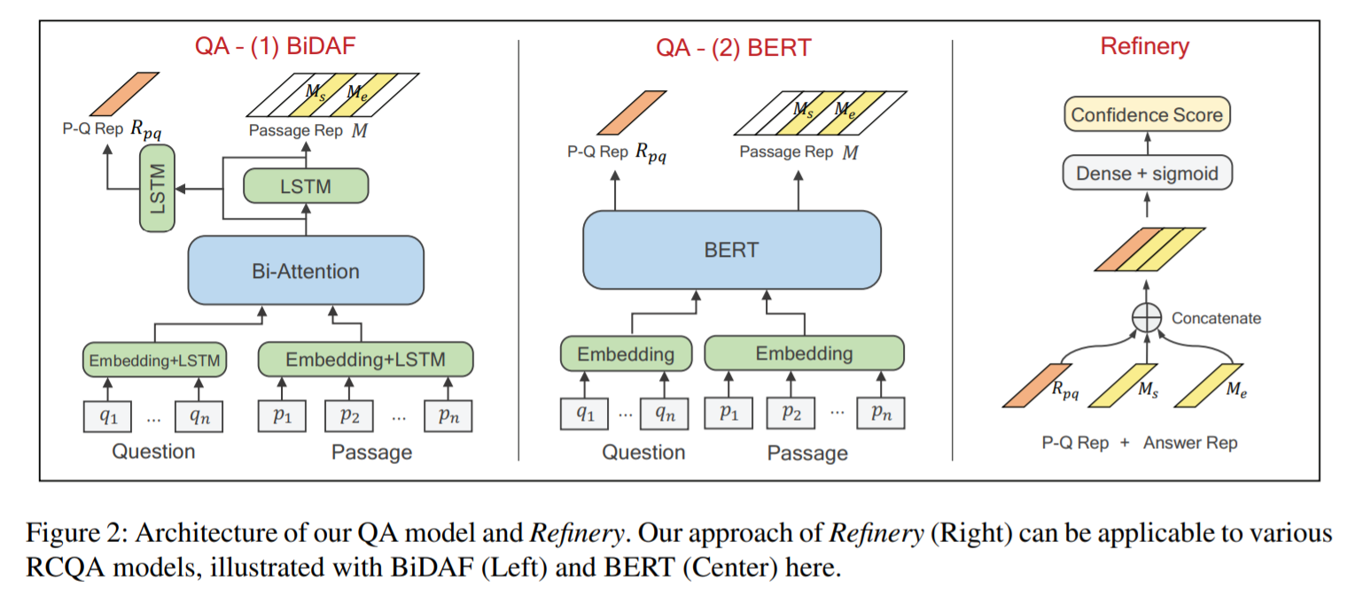
Weakly-supervised QA Model | Method

Slide 16
Weakly-supervised QA Model | Method
Refinery Network
score the quality of the generated (p, q, a) labels
Research Question:
how do we obtain positive and negative examples?

Slide 17
Weakly-supervised QA Model | Method
Refinery Network
score the quality of the generated (p, q, a) labels
Pseudo-positive label
Data generated from NMT and QG/AE
New labels which QA and refinery model update

Slide 18
Weakly-supervised QA Model | Method
Refinery Network
score the quality of the generated (p, q, a) labels
Generate negative label
replace a question with its semantic neighbor (“who first discovered america?” → “who first discovered canada?”)
modify a passage by removing a sentence containing the answer span
we perturb an answer span into a random span in the same passage
(p, q’, a), (p’, q, a), (p, q, a’)

Slide 19
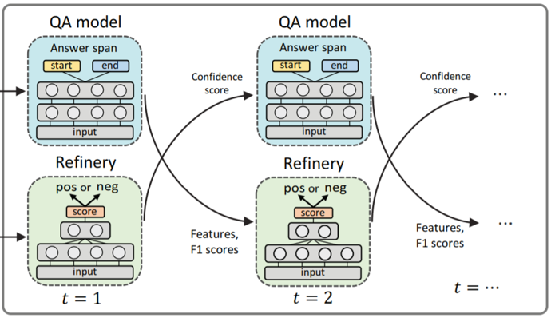
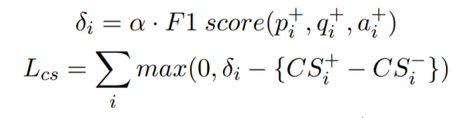
Weakly-supervised QA Model | Method
Training Loss
CS : Confidence Score for instance from Refinery Model
Notes:
Dynamic margin

Slide 20
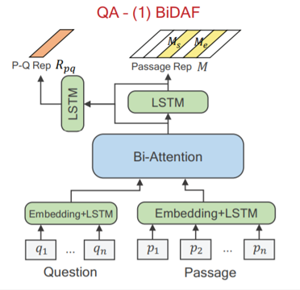
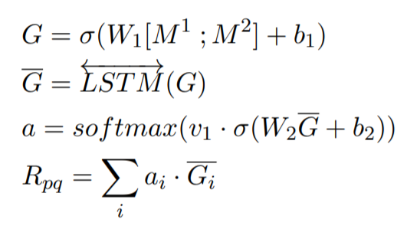
Weakly-supervised QA Model | Method
To get answerability from QA model …
Extract feature of (p, q) from QA model

Slide 21
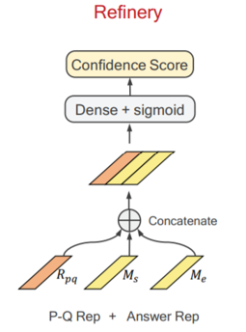

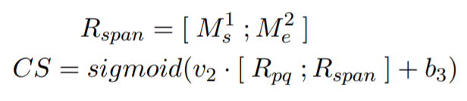
Weakly-supervised QA Model | Method
To get answerability from QA model …
Extract feature of (p, q) from QA model

Slide 22
Weakly-supervised QA Model | Method
Improving QA and Weak Labels
down-weighting instances with low-quality
answer modification with low-quality for higher quality.

Slide 23
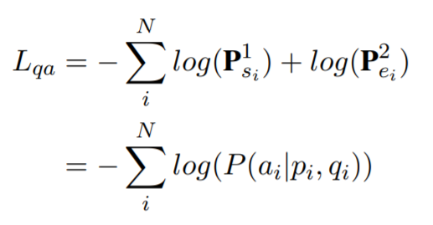


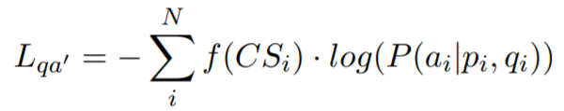
Weakly-supervised QA Model | Method
Improving QA and Weak Labels
down-weighting instances with low-quality
answer modification with low-quality for higher quality.

Slide 24
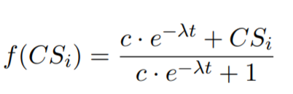
Weakly-supervised QA Model | Method
Improving QA and Weak Labels
down-weighting instances with low-quality
answer modification with low-quality for higher quality.
Annealing technique to adjusting the confidence score contribution

Slide 25
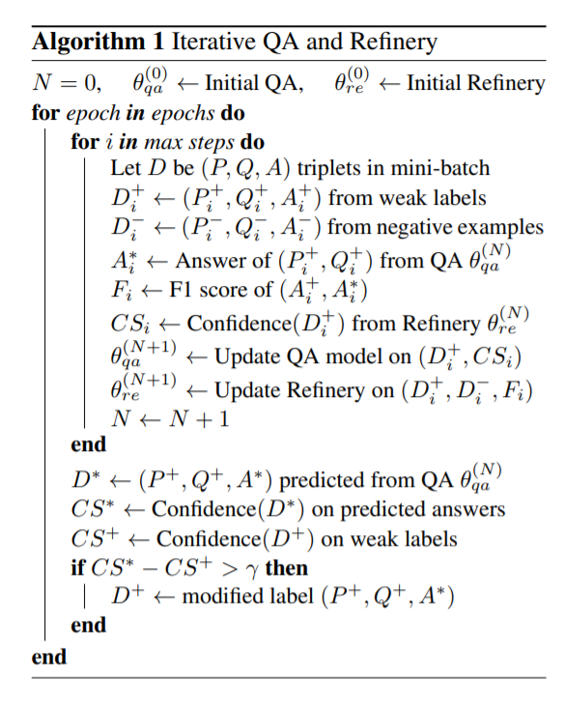
Weakly-supervised QA Model | Method

Slide 26
Experiment
• RQ1:
Does our proposed work outperform existing approaches?
Does it generalize for languages with diverse distance or topics?
• RQ2: Does our model generally work on more noisy environment?
• RQ3: Is our Refinery effective in distinguishing positive and negative set? How does QA/Refinery contribute to each other?

Slide 27
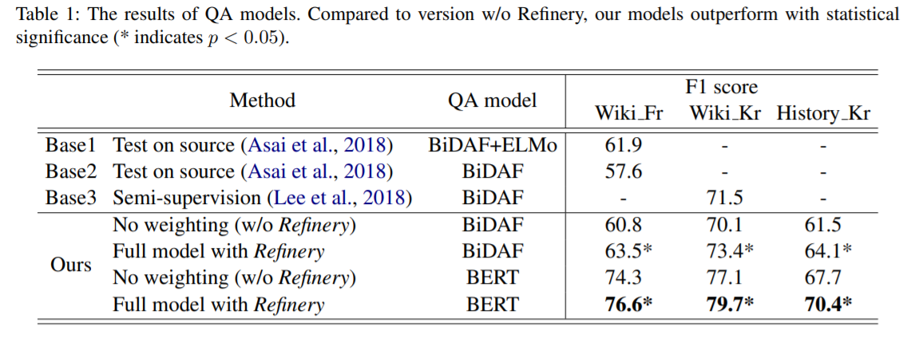
Experiment

Slide 28
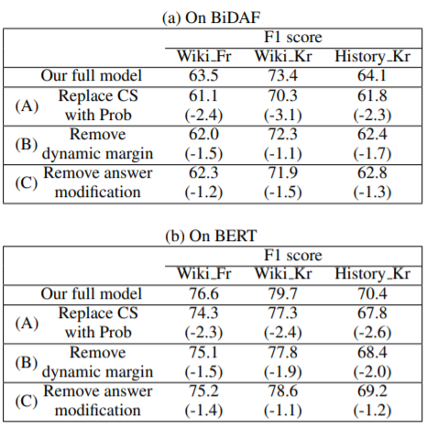
Experiment

Slide 29
Experiment
• RQ1:
Does our proposed work outperform existing approaches?
Does it generalize for languages with diverse distance or topics?
• RQ2: Does our model generally work on more noisy environment?
• RQ3: Is our Refinery effective in distinguishing positive and negative set? How does QA/Refinery contribute to each other?

Slide 30
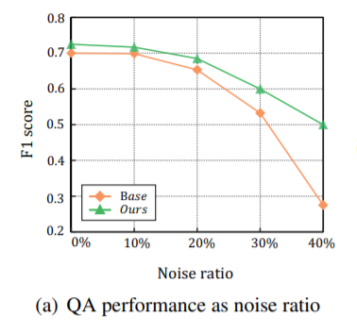
Experiment

Slide 31
Experiment
• RQ1:
Does our proposed work outperform existing approaches?
Does it generalize for languages with diverse distance or topics?
• RQ2: Does our model generally work on more noisy environment?
• RQ3: Is our Refinery effective in distinguishing positive and negative set? How does QA/Refinery contribute to each other?

Slide 32
Experiment

Slide 33
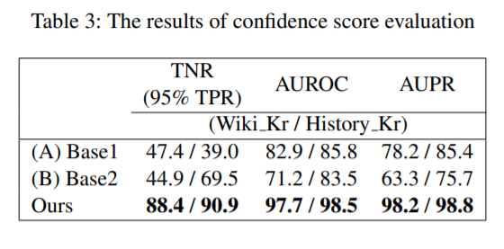
Experiment

Slide 34
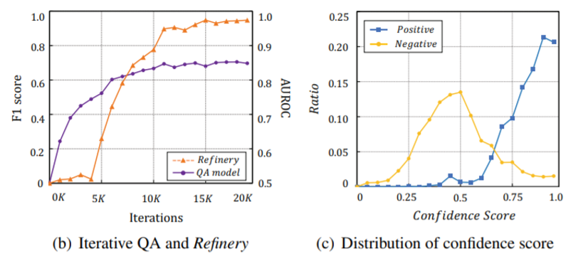
Experiment

Slide 35
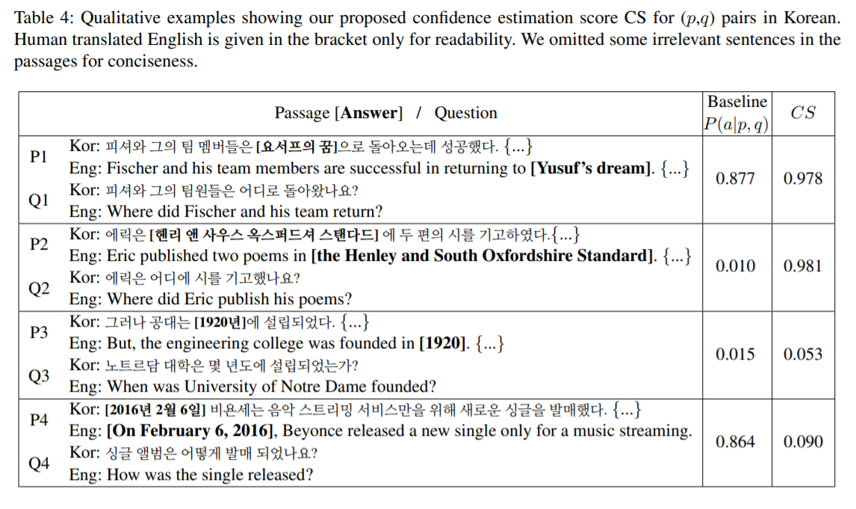
Experiment

Slide 36
Conclusion
Zero-resource training data generation
Generate dataset using NMT and QG technique
Down-weighting and answer modification for better dataset
→ Highly dependent on English SQuAD

